Slide 1


Bringing computational data science to your undergraduate ecology classroom
August 11, 2019
Ecological Society of America Meeting
Louisville, KY, USA

Slide 2
The Biological and Environmental Data Education Network
This workshop is brought to you by…
Network of scientist/educators
Integrate and normalize data science approaches in undergraduate biology and environmental science curricula.
Make data science more accessible, transparent, reproducible, and relevant.
Funded by NSF RCN-UBE Incubator Grant

Slide 3

Context & Motivation

Slide 4
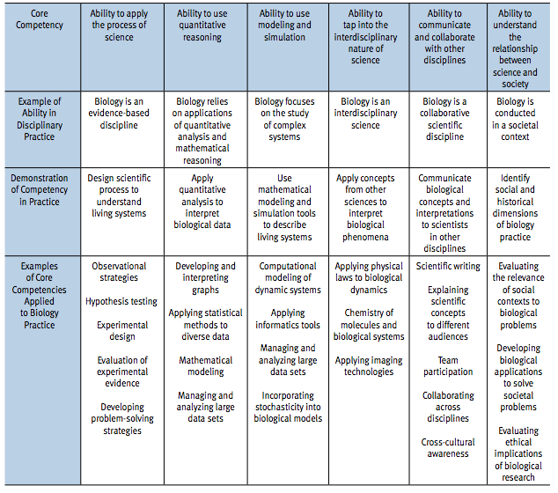
Core Competencies and Disciplinary Practices
Fully 1/3 of core competencies highlighted by Vision and Change are directly related to computation and data science, yet we do little to formally incorporate these skills into undergraduate curricula.

Slide 5
Data science education
Students Exposed
Introductory/Core Lectures and Labs
Specialized Courses
Where does it fit?
Additional Math/Stat or CS Courses
Research
Power of Competency

Slide 6
Main challenge
“…we are attempting to fit more material into already-full courses and curricula, which are taught by people who do not feel prepared to address topics relevant to big data and data-intensive research”
Hampton et al. (2017)

Slide 7
Main focus: Undergraduate instructors
Focusing on developing:
Fundamental technical skills in data science
Pedagogical confidence and empowerment
Inclusive instructional strategies

Slide 8
Curricular challenges
1. Gaps between the data science skills that students need and the knowledge and skills that faculty instructors have.
2. Curricula that are already crowded with conceptual material, laboratory techniques, and statistical training.

Slide 9
Curricular challenges
3. No curricular structure to scaffold skill development across courses.
4. Limited understanding among faculty concerning what the core competencies are for data-intensive, reproducible research and how they might fit into the curriculum.

Slide 10
BEDE Network Research Coordination Network in Undergraduate Biology Education - Incubator
1. A full RCN-UBE proposal
2. A position/review paper
3. “Train-the-Teachers” workshops

Slide 11

Welcome to the first BEDE Network “Train the teachers” workshop!
You are invited to participate in the BEDE Network in the Future
Please provide feedback both during the workshop and and afterward

Slide 12
BEDE Network will empower undergraduate instructors in biology and environmental science by providing both training opportunities and an inclusive and supportive community of colleagues with expertise in data science.
Empowerment precedes experience

Slide 13
So how should we actually teach computational data science to our students in biology and environmental science?

Slide 14
Backwards Design
Identify desired learning outcomes – what do you want students to learn?
Determine acceptable evidence – How will you assess whether they are learning?
Plan activities and instructional resources – What will you and the students need for students to learn?
Wiggens and McTighe, 2005, Understanding by Design

Slide 15
Identify desired learning outcomes
Workshop participants should be able to:
Recognize that data science can be integrated into undergraduate classes at all levels.
Consider how they might incorporate software tools into their own classroom, as appropriate.
Feel more confident in bringing data science to their students.

Slide 16
Determine acceptable evidence
We will assess workshop outcomes using:
Before and after responses to the BEDE Network survey.
Verbal and written feedback from workshop participants.
Follow-up participation in BEDE Network.

Slide 17
Plan activities and instructional resources
For the workshop, we will provide:
Background and conceptual content via interactive mini-lectures and discussions.
Focused training in basic technical skills.
Time for creative application of technical skills to the participants’ own classrooms.

